Slide 1

Capstone Project-Battle of the Neighborhoods
Analysis and Clustering of Japanese Restaurants in New York, USA Cassandra E Salotti August 29th, 2020

Slide 2
Business Problem
Identify an optimal location to open a Japanese Restaurant in New York, NY
Consider factors such as existing concentration of restaurants and population distribution of Japanese Americans in the New York Metropolitan and Greater New York City areas.

Slide 3
Data
Location details of current Japanese restaurants using Foursquare API Get Venue/Search Endpoint calls.
Geopy Nominatim to retrieve geo-coordinates for New York and Scarsdale (Westchester County, NY)
Additional location used for Foursquare API call since output is limited to 50 results.

Slide 4
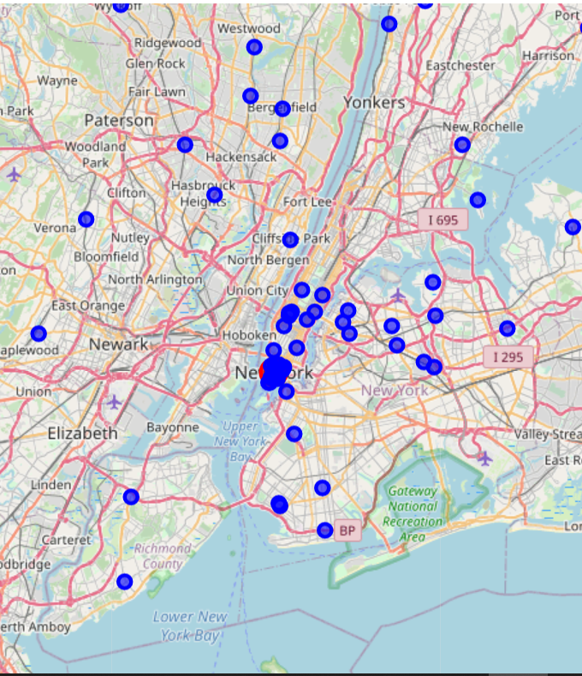
Exploratory Data Analysis
Plotting Restaurants on Map
71 Restaurants Identified

Slide 5
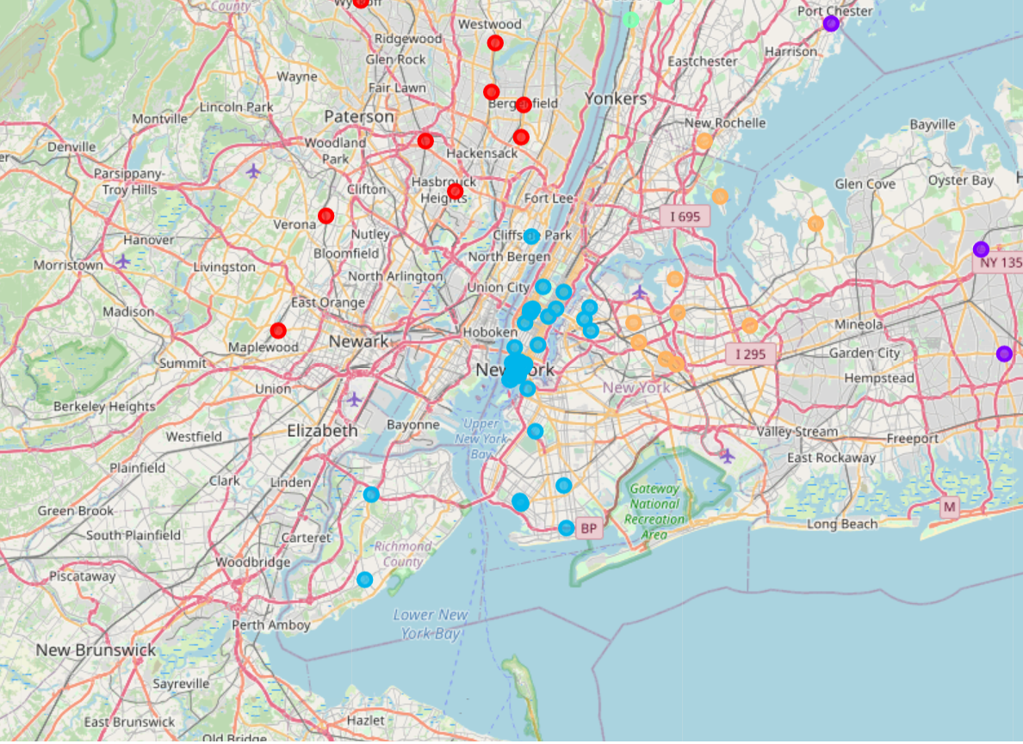
K-Means Clustering Algorithm
K-Means Clusters Identified on Map

Slide 6
Result and Discussion
Greater number of Japanese restaurants in Manhattan, Staten Island, Brooklyn, Westchester County, and Bergen County (NJ)
Queens is home to a good-size Japanese population but has far less Japanese restaurants
Manhattan would normally be considered ideal; however COVID-19 is hitting the food service industry the hardest here due to a lack of tourist influx plus remote working/learning for Japanese expatriates and students

Slide 7
Conclusion
The borough of Queens could be an ideal choice going forward to open new Japanese restaurants.
Northeastern and Central Queens should be considered for their substantial population of Asian Americans
Halting of travel due to pandemic means that Japanese restaurants would fare best in population-dense residential areas that are familiar with Japanese cuisine.

